Slide 1




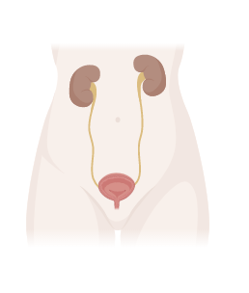
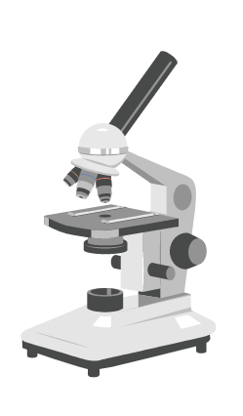
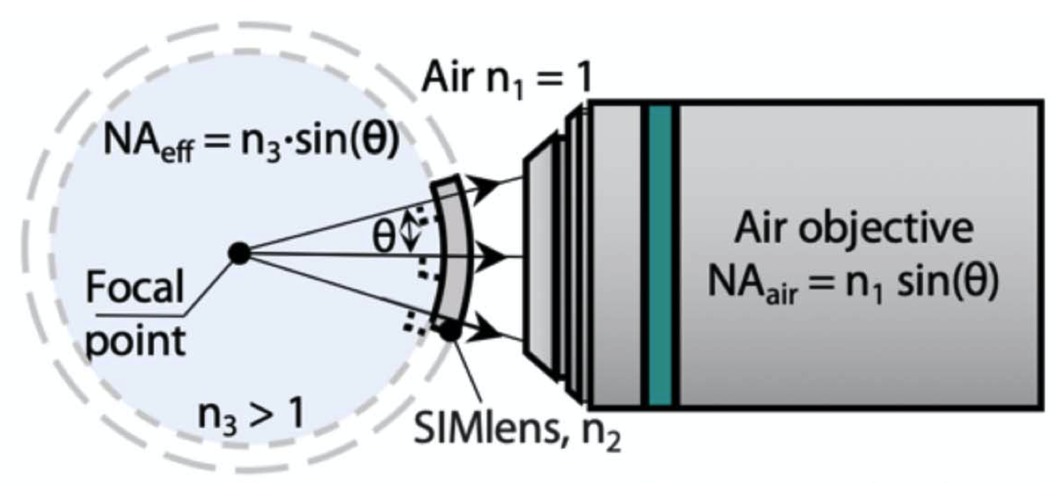

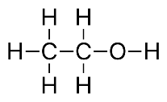

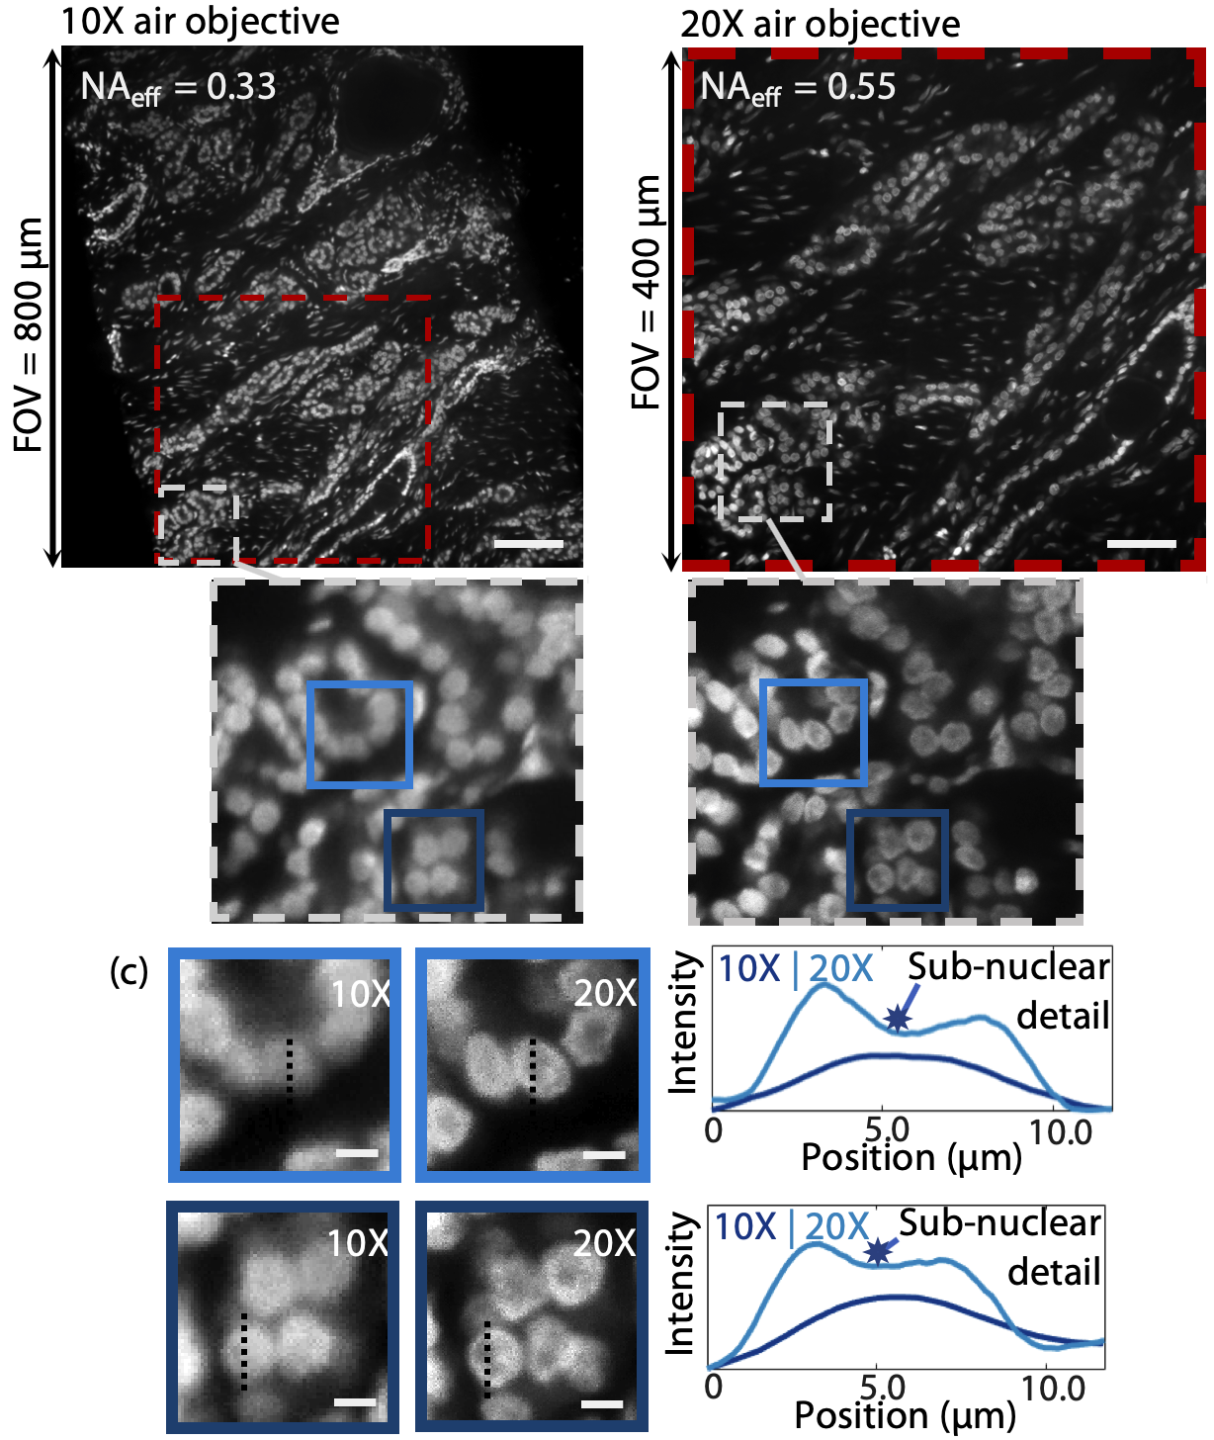
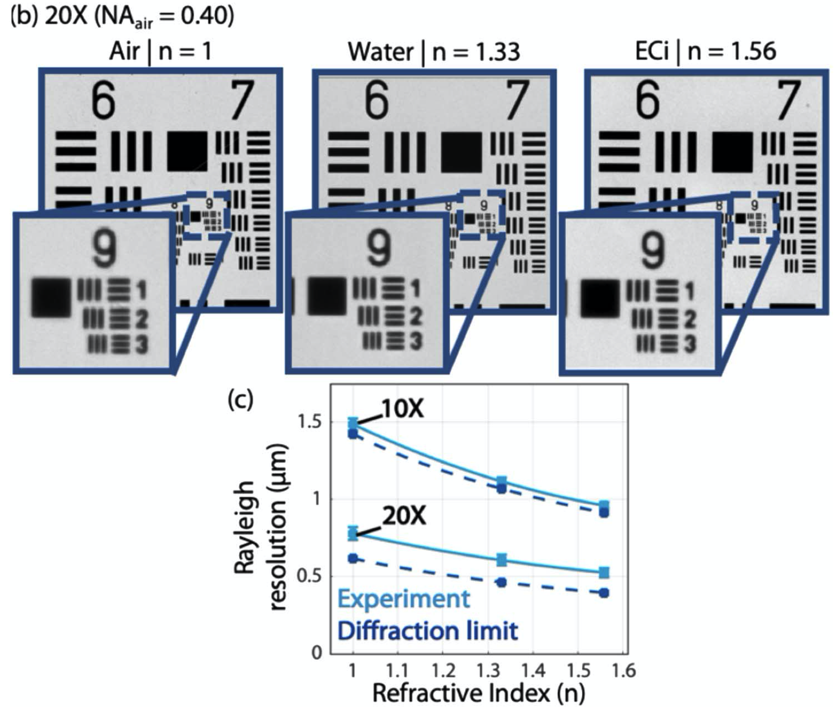
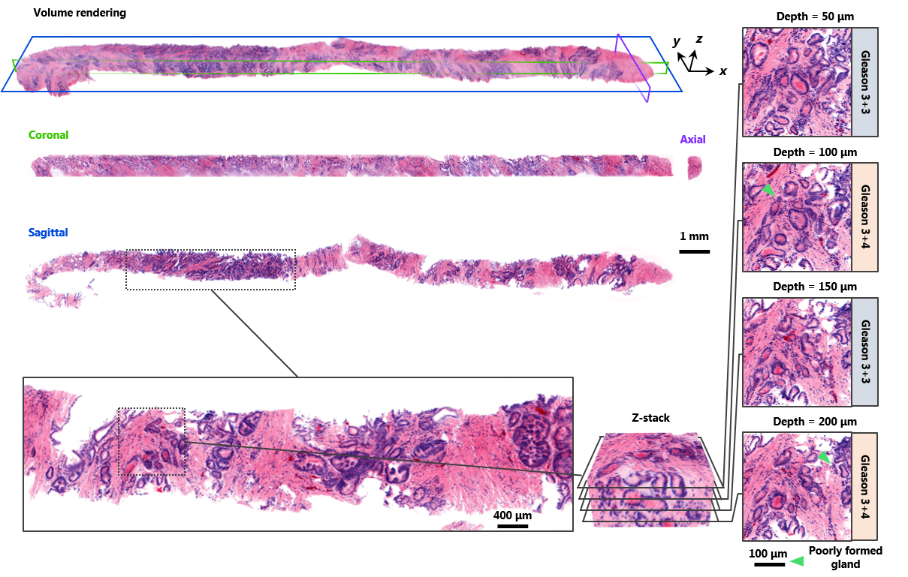
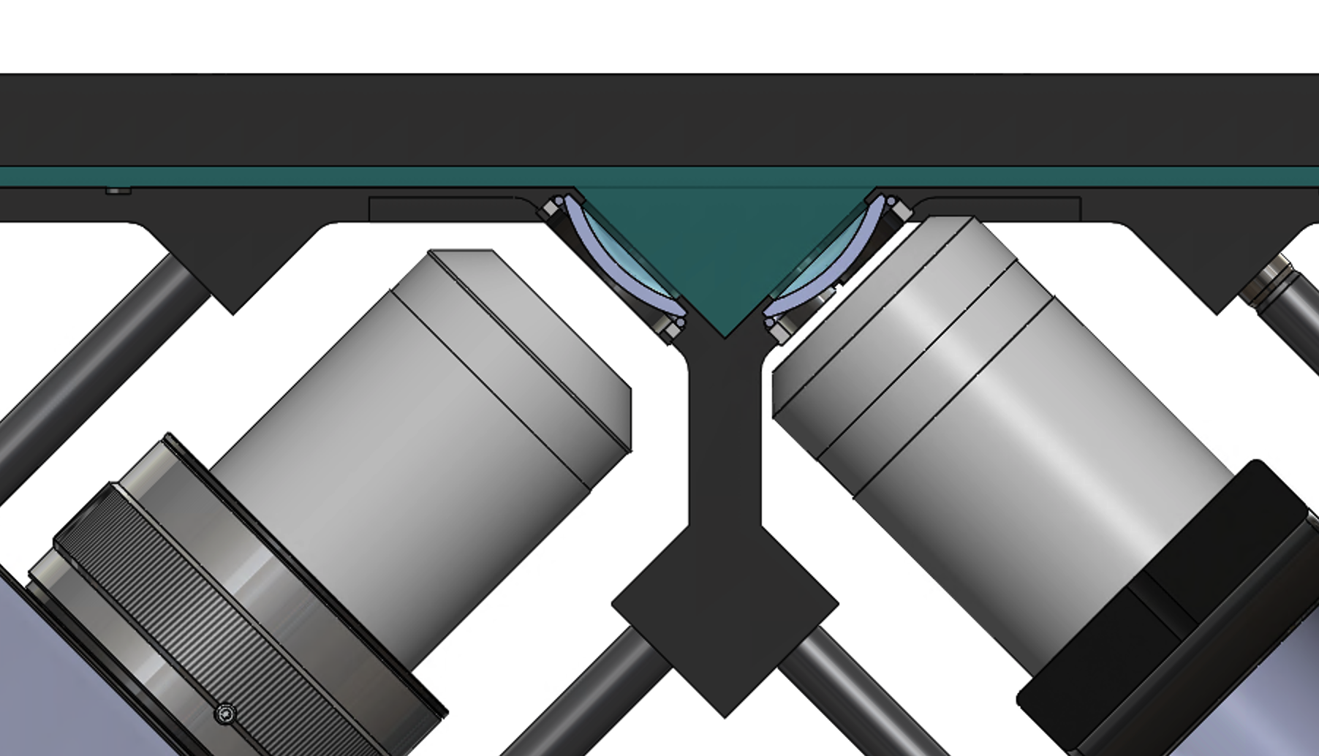
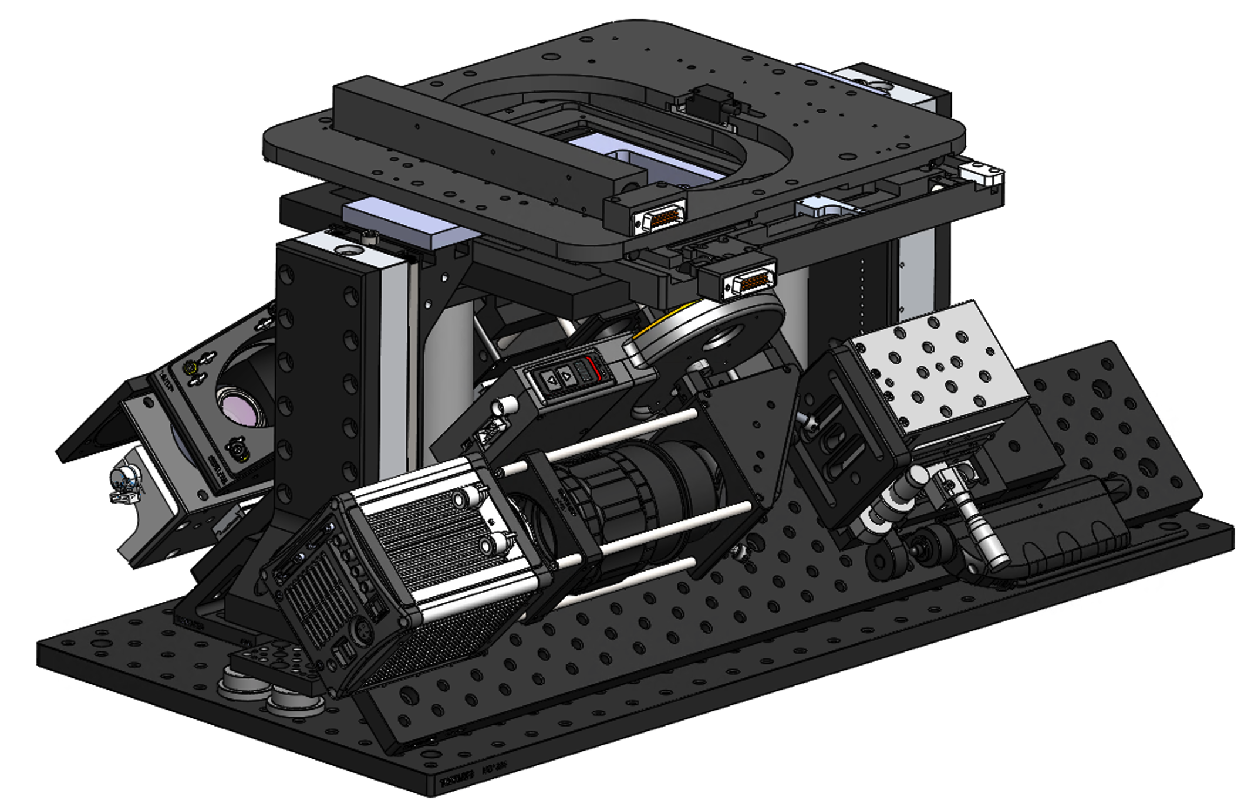
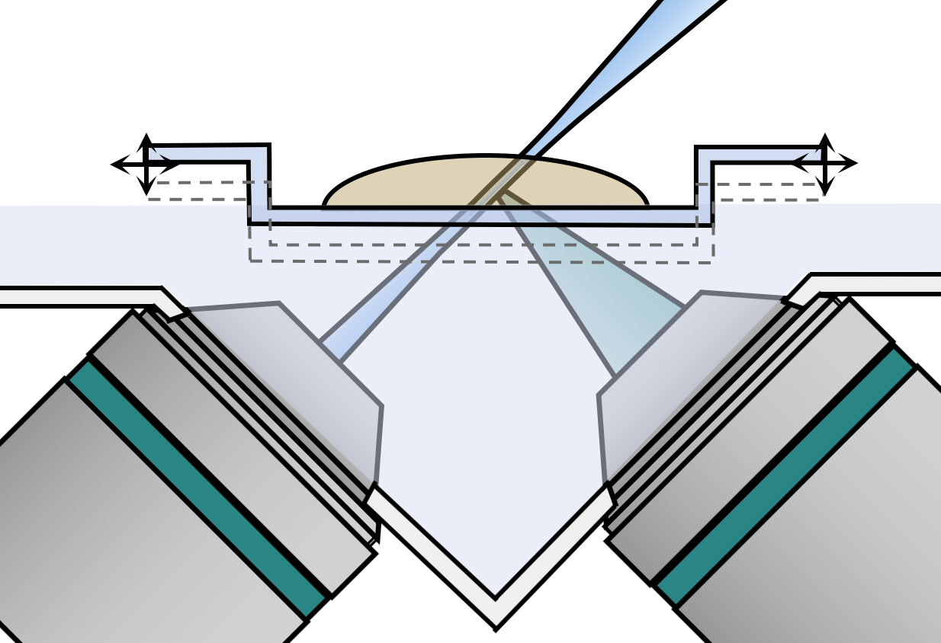
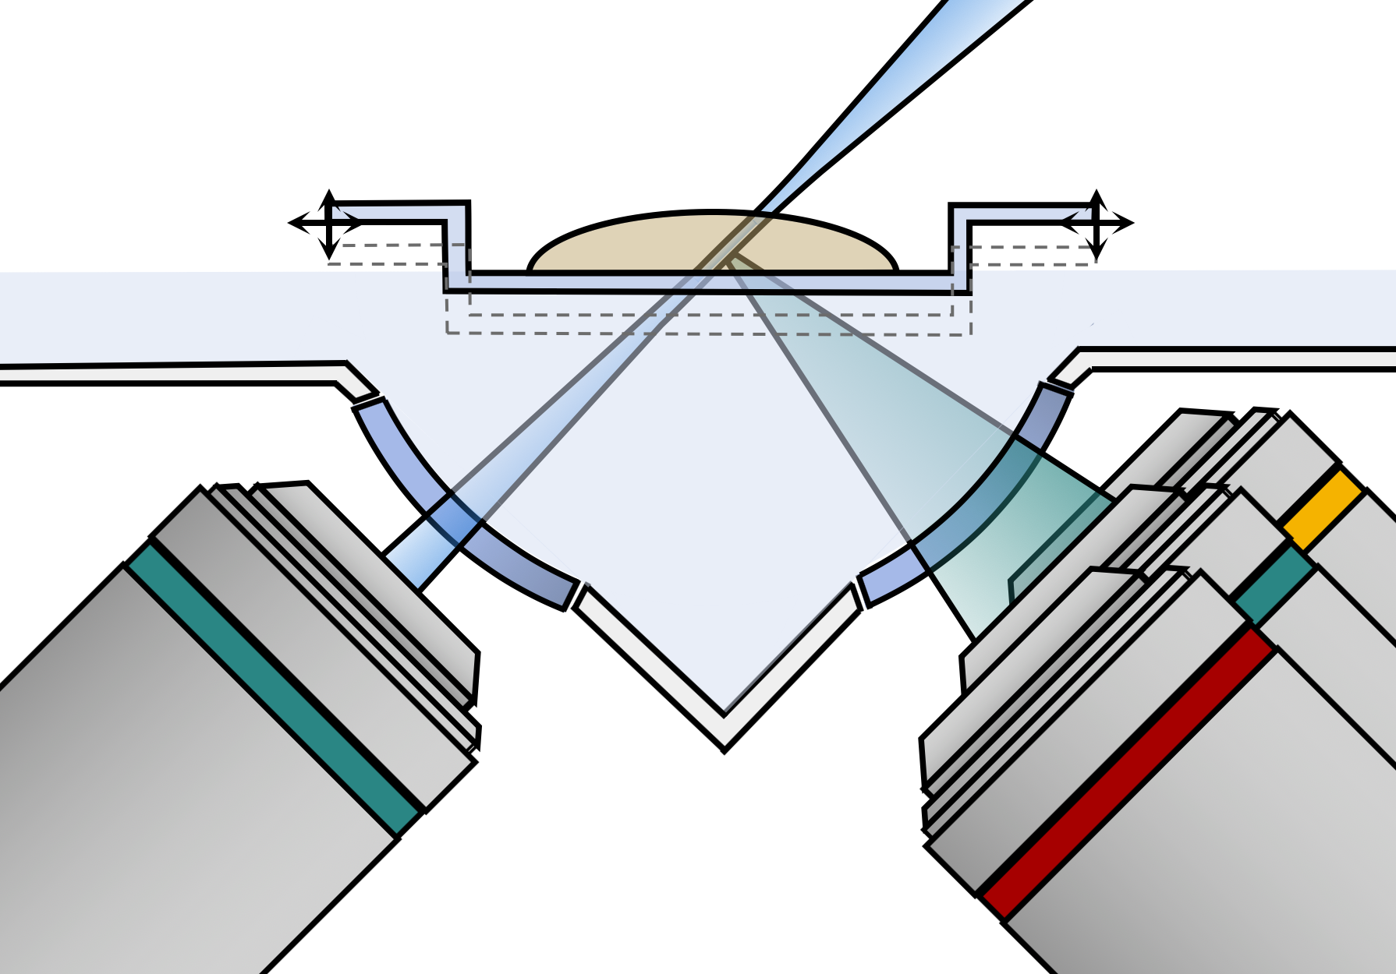
Multi-resolution open-top light-sheet (OTLS) microscopy for rapid 3D pathology
MECHANICAL ENGINEERING
IMECE 2019-13009
Lindsey A. Barner¹, Dr. Adam K. Glaser¹, Dr. Jonathan T.C. Liu^{1,2}(PI)
¹University of Washington, Department of Mechanical Engineering, ²University of Washington, Department of Pathology
IMECE Track 16-1
NSF Research Poster Competition
Background and motivation
The gold standard for prognosis and treatment stratification of cancer patients relies on conventional histopathology, a dated and labor-intensive technique that suffers from limited 2D sampling and inter-observer variability.
This compromises the accuracy of cancer diagnoses, which leads to over-treatment of patients with indolent cancer (non-life-threatening disease), or under-treatment of high-risk patients which leads to increased mortality.
Surgery
Preparation
2D imaging
Manual analysis
Experimental setup and results:
Design and validation of a SIMlens to enable multi-resolution imaging in light-sheet microscopy
Collection
Dehydration
Sectioning
Mounting
Lab microscope
SIMlens design concept
Multi-resolution imaging demonstration of a prostate core-needle biopsy with SIMlens-based light-sheet microscopy
SIMlens and 10X air objective
SIMlens and 20X air objective
Fixation
Embedding
Staining:
Hematoxylin Eosin
Prior work: Open-top light-sheet microscopy for rapid 3D pathology
Architecture of open-top light-sheet microscope
We have developed open-top light-sheet microscopy for nondestructive, slide-free and volumetric pathology of clinical specimens. Intact tissues can be rapidly imaged over large volumetric fields of view. The utility of this technology has been demonstrated for several applications in clinical pathology, including volumetric assessment of core-needle biopsies in toto.
Specimens
A SIMlens provides a wavefront-matching interface between an air-based objective and any immersion media. This provides a number of advantages in context of OTLS microscopy:
Boost in NA by a factor of n₃
Accommodates samples with a wide variety of clearing protocols
Enables vertical movement of the sample (in contrast to 1st-generation OTLS microscopy)
Optical design of open-top light-sheet microscope
Performance validation of a SIMlens: Images of resolution target in various immersion media
Specimen mounting
Sample holder
Immersion media
Motorized XYZ stage
Camera
Immersion chamber
Detection
Illumination
Open-top light-sheet microscopy (3D) of prostate core needle biopsy
Laser
The same region of the tissue is imaged with 10X and 20X air-based objectives and a SIMlens, demonstrating the ability to rapidly switch between objectives to zoom into regions of interest in the specimen.
Future studies:
Now that the design and performance of a SIMlens has been validated, our goal is to design and assemble a SIMlens-based OTLS microscope for imaging post-operative prostatectomy specimens. The ability to rapidly screen at low magnification and subsequently zoom in at high resolution would enable rapid screening for lymphovascular invasion, a prognostic indicator that due to its sparse distribution in prostate tissue is difficult to identify with 2D conventional histology.
Optical design of multi-resolution open-top light-sheet microscope
Architecture of multi-resolution open-top light-sheet microscope
Goal: Multi-resolution open-top light-sheet microscopy for rapid 3D pathology
In current histology practice, pathologists first view slide-mounted histology sections at low magnification to rapidly inspect large tissue regions before subsequently imaging ambiguous tissue regions at higher magnification. Similarly, the ability to perform multi-resolution (i.e. multi-magnification) imaging in OTLS microscopy would improve its utility in 3D pathology, further accelerating the translation of OTLS into clinical settings.
Therefore, we aim to enable multi-resolution OTLS microscopy by developing a solid immersion meniscus lens (SIMlens), which enables the use of air-based detection objectives that can be easily switched for multi-magnification imaging (unlike immersion-based objectives).
Sample
Sample plate
Immersion bath
SIMlens
Immersion-objective-based OTLS microscopy: does not allow for multi-resolution imaging
SIMlens-based OTLS microscopy: enables multi-resolution imaging with air-based objectives
Air-based detection objective(s)
Sample, n₃
Sample plate, n₃
Sample, n₃
Sample plate, n₃
Illumination
Immersion bath, n₃
20X
Conclusion:
We have developed a SIMlens, a wavefront-matching lens element designed for multi-resolution open-top light-sheet microscopy. In addition to enabling multi-resolution imaging of clinical specimens in 3D, a SIMlens provides a number of advantages over previous OTLS architectures.
Immersion bath, n₃
SIMlens, n₂
10X
5X
References and publications:
Barner, L. et al. Solid immersion meniscus lens (SIMlens) for open-top light-sheet microscopy. Optics Letters. 44 (18) 4451-4454 (2019).
Glaser, A. et al. Light-sheet microscopy for slide-free non-destructive pathology of large clinical specimens. Nature Biomedical Engineering. 1 (0084) 1-10 (2017).
Glaser, A. et al. Multi-immersion open-top light-sheet microscopy for high-throughput imaging of cleared tissues. Nature Communications. 10 (1038) 1-10 (2019).
Acknowledgments: NSF GRFP (Barner), Achievement Rewards for College Scientists Foundation (Barner), Prostate Cancer Foundation, U.S. Department of Defense (PC170176), NIH (F32 CA213615, K99 CA240681, R01 CA175391). The authors would also like to thank NSF for supplemental travel funds to this competition from grant CMMI-1935462.
Illumination
Detection objective (immersion)
Illumination
Air-based detection objective(s)

